Slide 1



The Future of the SGA
Craig Beeston, SGA Programme Manager
SGA Annual Conference – Cascading Good Governance
23 November 2022
In partnership with

Slide 2

SGA extension
The Chartered Governance Institute has agreed with Sport England and the Sports Councils to deliver the SGA until 2027
Will build on the foundations laid so far
The SGA will be extended geographically
Exciting new elements will be added to the Academy

Slide 3






The SGA and the Sports Councils

Slide 4
Powered by the sector
Listening to the SGA community
Working closely with the Sports Councils
Working in partnership with other providers of governance support in the sector
  to create content
  to signpost users to the best resources
Become the go-to hub for governance support

Slide 5
Proposed outcomes
Demystify governance
A culture of good governance that goes beyond compliance
Pathways of continuous learning and professional development
Increased confidence in and recognition of the expertise, experience and occupational competence of those working in governance
Gateways for cross-sector engagement and learning

Slide 6
SGA offering
Will continue to provide:
Training
Knowledge base
Blogs
Newsletters & updates
Webinars
Essays in sports governance
Networking events
Annual conference
Board development training

Slide 7
New offering - Certification
CGIUKI’s Level 4 Certificate in Sports Governance
  To be re-developed 2022-23
  Content updated for flexible delivery
  Series of 4 standalone modules, or
  Complete course leading to certification
Content to be mapped to CGIUKI’s revised Competency Framework

Slide 8
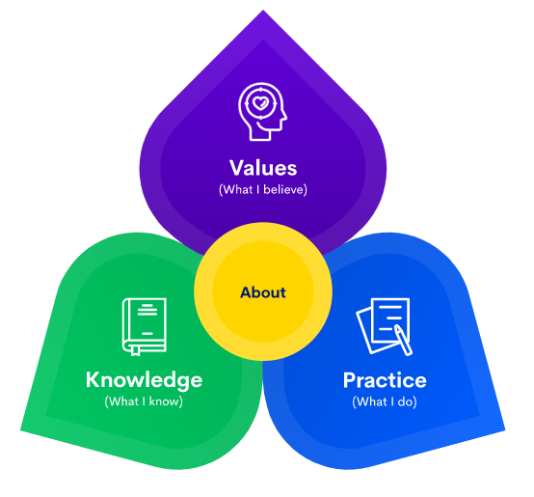
Competency Framework
12 professional competencies, divided into
  Values
  Practice
  Knowledge
Assessed at 4 proficiency levels:
  Entry,
  Emerging,
  Established, &
  Expert

Slide 9
Competency Framework
Can be used to help with
  Identifying a career path
  Transitioning into governance
  Identifying own training and development pathway
  Recruitment, succession planning and staff development
  https://www.cgi.org.uk/professional-development/competency-framework

Slide 10
New offering – Mentoring scheme
Peer-to-peer scheme
In response to feedback from SGA community and key stakeholders
Competency Framework used to identify areas for development
Will look to create a fresh, contemporary scheme
Development in 2022-23

Slide 11
Calls to action
Spread the word
Encourage colleagues to register
Get involved

Slide 12
Thank you
www.sportsgovernanceacademy.org
In partnership with

